Slide 1
Digital System Design
Book Reference
Digital Systems
Principles and Applications
Author- Ronald J. Tocci, Neal S. Widmer

Slide 2
Digital Logic Circuit
Two types of Logic Circuit
Combinational Logic Circuit
Sequential Logic Circuit

Slide 3
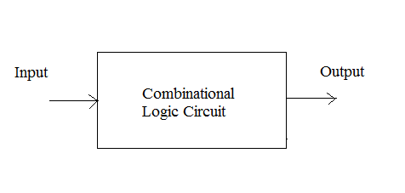
Combinational Logic Circuit
Combinational logic Circuit consists of logic gates whose outputs at anytime are determined directly from the present combination of inputs without regard to previous inputs.

Slide 4
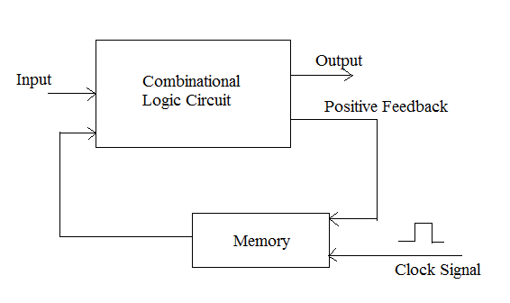
Sequential Logic Circuit
Sequential logic Circuit consists of logic gates whose outputs are a function of the inputs and the state of memory elements. The state of memory elements, in turn, is a function of previous inputs.

Slide 5
Combinational Circuit Vs Sequential Circuit
Main difference between them is that combinational circuit does not use memory and thus here output depends only on current input. Also there is no need of clock here.
Now sequential circuits use memory and thus there output depends on current input plus previous output. They employ a feedback loop to give output back to input.
Examples of combinational circuits are full adder, Code converter, multiplexer, decoder , encoder etc.
Examples of sequential circuit are counter, shift registers etc.

Slide 6
Maxterm and Minterm
Minterm
For n variables, the minterm is a product (•, AND) term that contains each variable exactly once, in complemented or uncomplemented form.
In minterm m_{j}, a variable is complemented if its value in the binary equivalent of j is 0.

Slide 7
Maxterm and Minterm
Maxterm
For n variables, the maxterm is a sum (+, OR) term which contains each variable exactly once, in complemented or uncomplemented form
In maxterm M_{j}, a variable is complemented if its value in the binary equivalent of j is 1.

Slide 8
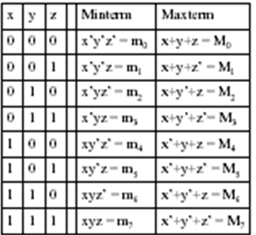
Minterms and Maxterms are easy to denote using a truth table.
Example (3 variables):

Slide 9
Canonical Form
Any Boolean function f( ) can be expressed as a unique sum of minterms (SOP) (except for commutativity).The minterms included are those mj such that f( ) = 1 in row j of the truth table for f( ).
Any Boolean function f( ) can be expressed as a unique product of maxterms (POS) (except for commutativity). The maxterms included are those Mj such that f( ) = 0 in row j of the truth table for f().

Slide 10

Truth table for f1(a,b,c):
The canonical sum-of-products form for f1() is
f1(a,b,c) = a’b’c + a’bc’ + ab’c’ + abc’
The canonical product-of-sums form for f1() is
f1(a,b,c)= (a+b+c)•(a+b’+c’)•(a’+b+c’)•(a’+b’+c’).

Slide 11
A | B | C | F
0 | 0 | 0 | 0
0 | 0 | 1 | X
0 | 1 | 0 | 1
0 | 1 | 1 | X
1 | 0 | 0 | 1
1 | 0 | 1 | 0
1 | 1 | 0 | X
1 | 1 | 1 | 1
The minterm expansion is:
F(A,B,C) = Σm(2,4,7) + Σd(1,3,6)
The maxterm expansion is:
F(A,B,C) = Π M(0,5) . Π D(1,3,6)

Slide 12
CODE CONVERTERS
A code converter is a logic circuit that changes data presented in one type of binary code to another type of binary code, such as BCD to binary, BCD to 7−segment, binary to BCD, BCD to XS3, binary to Gray code, and Gray code to binary.
We know that, two digit decimal values ranging from 00 to 99 can be represented in BCD by two 4−bit code groups.

Slide 13
BCD-to-Binary Conversion
One method of BCD-to-Binary code conversion uses adder circuits :
The value, or weight, of each bit in the BCD number is represented by a binary number
All of the binary representations of the weights of bits that are 1s in the BCD number are added
The result of this addition is the binary equivalent of the BCD number

Slide 14


Contd...
For example, 46₁₀ is represented as
The MSB has a weight of 10, and the LSB has a weight of 1.
So the most significant 4−bit group represents 40, and the least significant 4−bit group represents 6 as in Table.

Slide 15
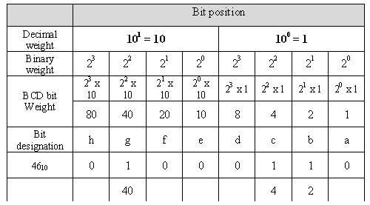
Weight Table

Slide 16
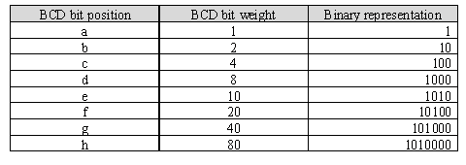
The binary equivalent of each BCD bit is a binary number representing the BCD bit weight

Slide 17
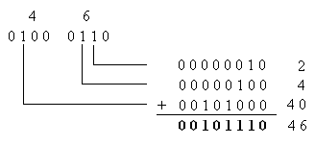
The result from the addition of the binary representation for
the weights of all the 1s in the BCD number is the binary
number that corresponds to the BCD number.

Slide 18
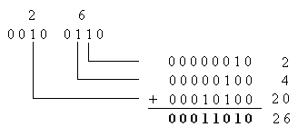
Example :
Convert the BCD equivalent of 26 to binary.
Solution

Slide 19
FOUR BIT BINARY TO GRAY CODE CONVERTER –DESIGN (1)…
MSB
0
+
1
+
1
+
0
+
1
Binary code
TRUTH TABLE:
0
1
0
1
1
Gray code
INPUT ( BINARY) |  |  |  |  | OUTPUTS (GRAY CODE)
B3 | B2 | B1 | B0 |  | G3 | G2 | G1 | G0
0 | 0 | 0 | 0 |  | 0 | 0 | 0 | 0
0 | 0 | 0 | 1 |  | 0 | 0 | 0 | 1
0 | 0 | 1 | 0 |  | 0 | 0 | 1 | 1
0 | 0 | 1 | 1 |  | 0 | 0 | 1 | 0
0 | 1 | 0 | 0 |  | 0 | 1 | 1 | 0
0 | 1 | 0 | 1 |  | 0 | 1 | 1 | 1
0 | 1 | 1 | 0 |  | 0 | 1 | 0 | 1
0 | 1 | 1 | 1 |  | 0 | 1 | 0 | 0
1 | 0 | 0 | 0 |  | 1 | 1 | 0 | 0
1 | 0 | 0 | 1 |  | 1 | 1 | 0 | 1
1 | 0 | 1 | 0 |  | 1 | 1 | 1 | 1
1 | 0 | 1 | 1 |  | 1 | 1 | 1 | 0
1 | 1 | 0 | 0 |  | 1 | 0 | 1 | 0
1 | 1 | 0 | 1 |  | 1 | 0 | 1 | 1
1 | 1 | 1 | 0 |  | 1 | 0 | 0 | 1
1 | 1 | 1 | 1 |  | 1 | 0 | 0 | 0

Slide 20
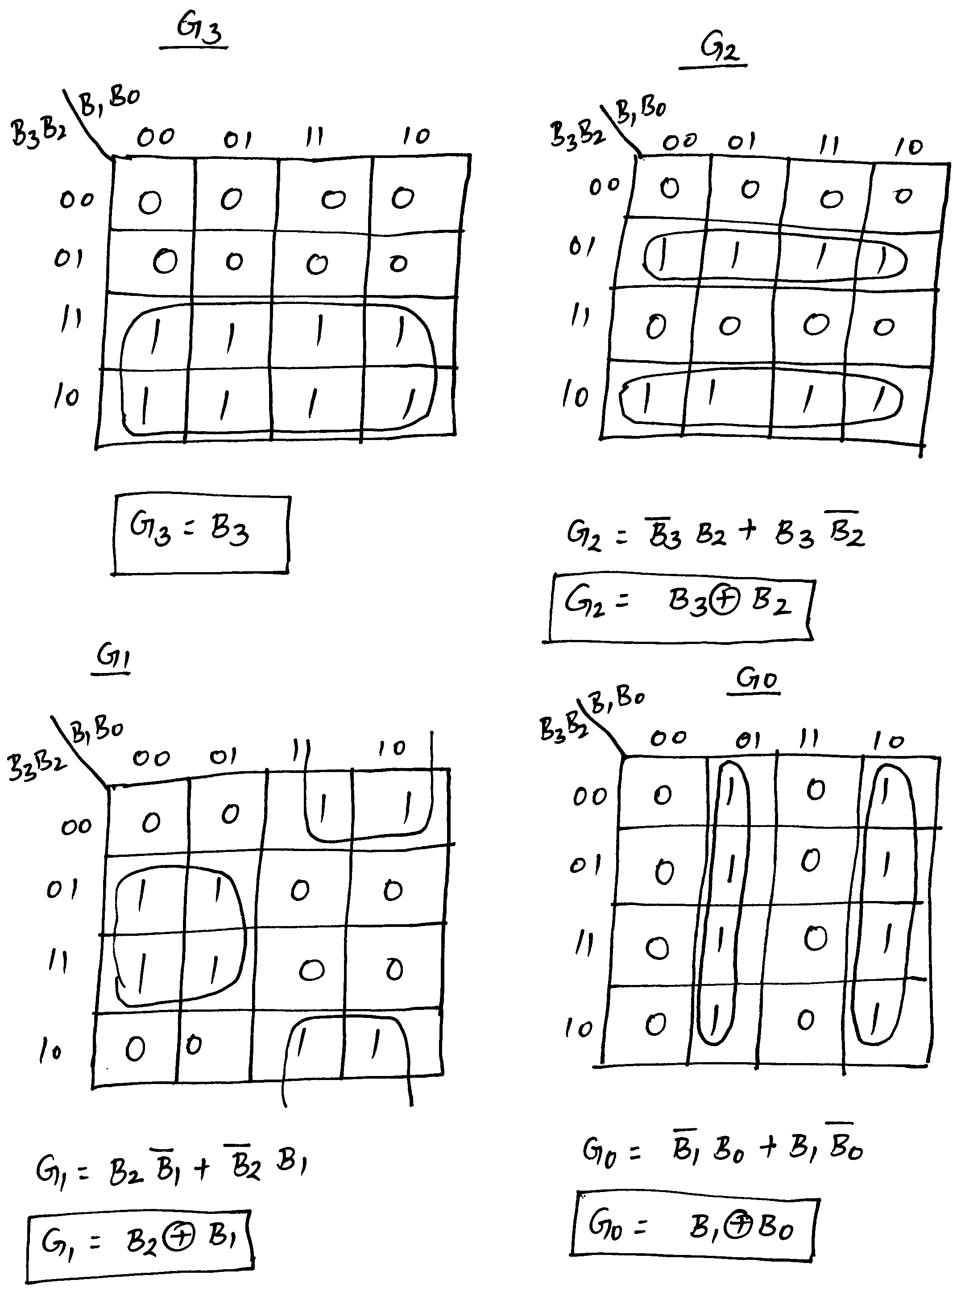
FOUR BIT BINARY TO GRAY CODE CONVERTER –DESIGN (2)…
Simplification using K-maps:

Slide 21
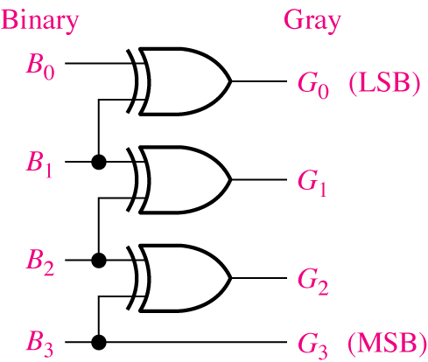
FOUR BIT BINARY TO GRAY CODE CONVERTER –DESIGN (3)
Logic Diagram:

Slide 22
FOUR BIT GRAY CODE TO BINARY CONVERTER –DESIGN (1)…
MSB
1
+
0
+
1
+
0
+
0
Gray code
Truth Table:
Binary code
1
1
0
0
0
INPUT ( GRAY CODE) |  |  |  |  | OUTPUTS (BINARY )
G3 | G2 | G1 | G0 |  | B3 | B2 | B1 | B0
0 | 0 | 0 | 0 |  | 0 | 0 | 0 | 0
0 | 0 | 0 | 1 |  | 0 | 0 | 0 | 1
0 | 0 | 1 | 0 |  | 0 | 0 | 1 | 1
0 | 0 | 1 | 1 |  | 0 | 0 | 1 | 0
0 | 1 | 0 | 0 |  | 0 | 1 | 1 | 1
0 | 1 | 0 | 1 |  | 0 | 1 | 1 | 0
0 | 1 | 1 | 0 |  | 0 | 1 | 0 | 0
0 | 1 | 1 | 1 |  | 0 | 1 | 0 | 1
1 | 0 | 0 | 0 |  | 1 | 1 | 1 | 1
1 | 0 | 0 | 1 |  | 1 | 1 | 1 | 0
1 | 0 | 1 | 0 |  | 1 | 1 | 0 | 0
1 | 0 | 1 | 1 |  | 1 | 1 | 0 | 1
1 | 1 | 0 | 0 |  | 1 | 0 | 0 | 0
1 | 1 | 0 | 1 |  | 1 | 0 | 0 | 1
1 | 1 | 1 | 0 |  | 1 | 0 | 1 | 1
1 | 1 | 1 | 1 |  | 1 | 0 | 1 | 0

Slide 23
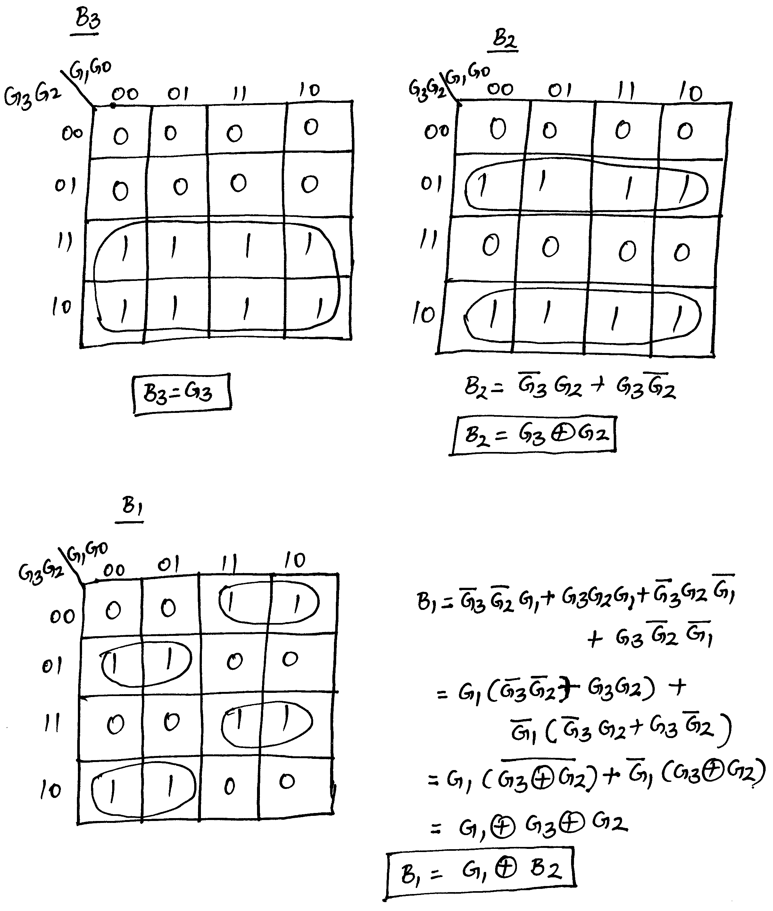
FOUR BIT GRAY CODE TO BINARY CONVERTER –DESIGN (2)…
Simplification using K-Maps:

Slide 24
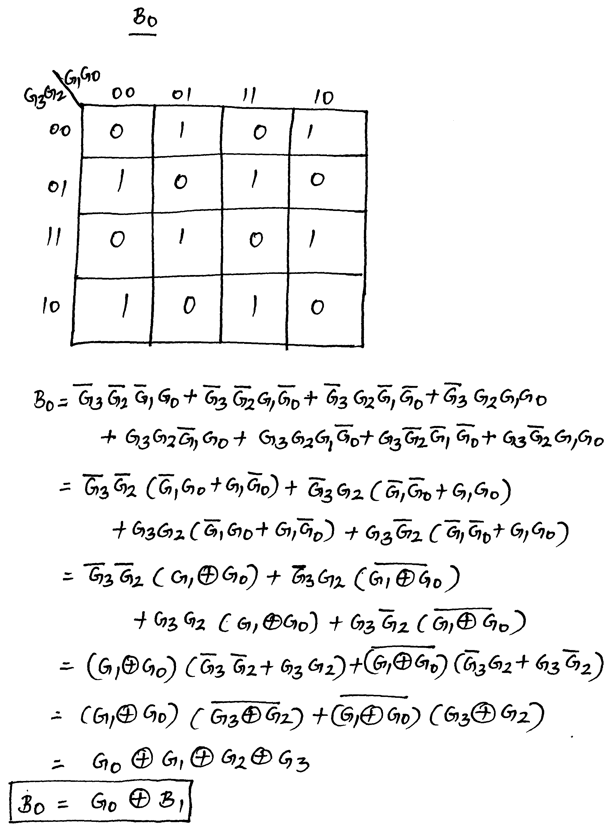
FOUR BIT GRAY CODE TO BINARY CONVERTER –DESIGN (3)…
Simplification using K-Maps:

Slide 25
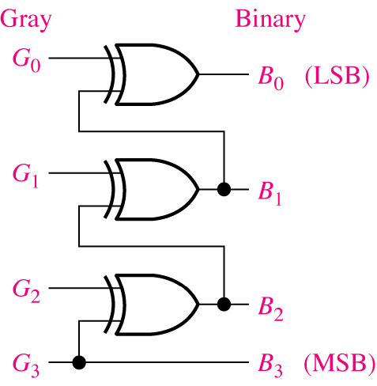
FOUR BIT GRAY CODE TO BINARY CONVERTER –DESIGN (4)
Logic Diagram:

Slide 26
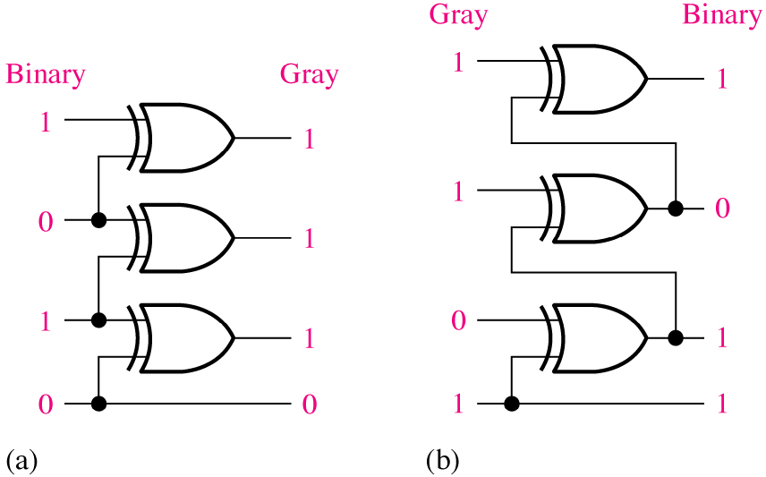
Exercise
Convert the binary number 0101 to Gray code with XOR
gates
Convert the gray code 1011 to binary with XOR gates
Solution:

Slide 27
BCD to XS 3 code converter- Design (1)...
      TRUTH TABLE FOR BCD TO XS3 CODE CONVERTER:
Input ( Std BCD code) |  |  |  |  | Output ( XS3 Code)
A | B | C | D |  | w | x | y | z
0 | 0 | 0 | 0 |  | 0 | 0 | 1 | 1
0 | 0 | 0 | 1 |  | 0 | 1 | 0 | 0
0 | 0 | 1 | 0 |  | 0 | 1 | 0 | 1
0 | 0 | 1 | 1 |  | 0 | 1 | 1 | 0
0 | 1 | 0 | 0 |  | 0 | 1 | 1 | 1
0 | 1 | 0 | 1 |  | 1 | 0 | 0 | 0
0 | 1 | 1 | 0 |  | 1 | 0 | 0 | 1
0 | 1 | 1 | 1 |  | 1 | 0 | 1 | 0
1 | 0 | 0 | 0 |  | 1 | 0 | 1 | 1
1 | 0 | 0 | 1 |  | 1 | 1 | 0 | 0
1 | 0 | 1 | 0 |  | X | X | X | X
1 | 0 | 1 | 1 |  | X | X | X | X
1 | 1 | 0 | 1 |  | X | X | X | X
1 | 1 | 1 | 0 |  | X | X | X | X
1 | 1 | 1 | 1 |  | X | X | X | X

Slide 28
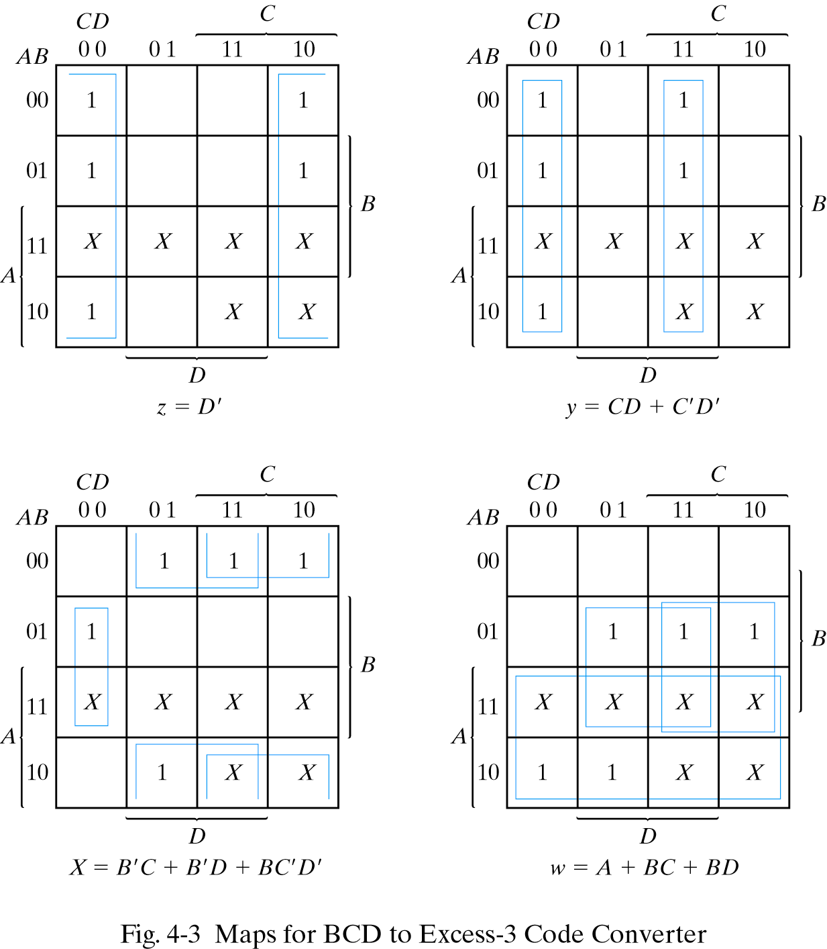
BCD to XS 3 code converter- Design (2)...
K-maps for simplification and simplified Boolean expressions

Slide 29
BCD to XS 3 code converter- Design (3)...
After the manipulation of the Boolean expressions for using common gates for two or more outputs, logic expressions can be given by
z=D’
y=CD+C’D’ = (C+D)’
x= B’C + B’D + BC’D’ = B’(C+D) + BC’D’
w= A + BC + BD = A + B (C+D)

Slide 30
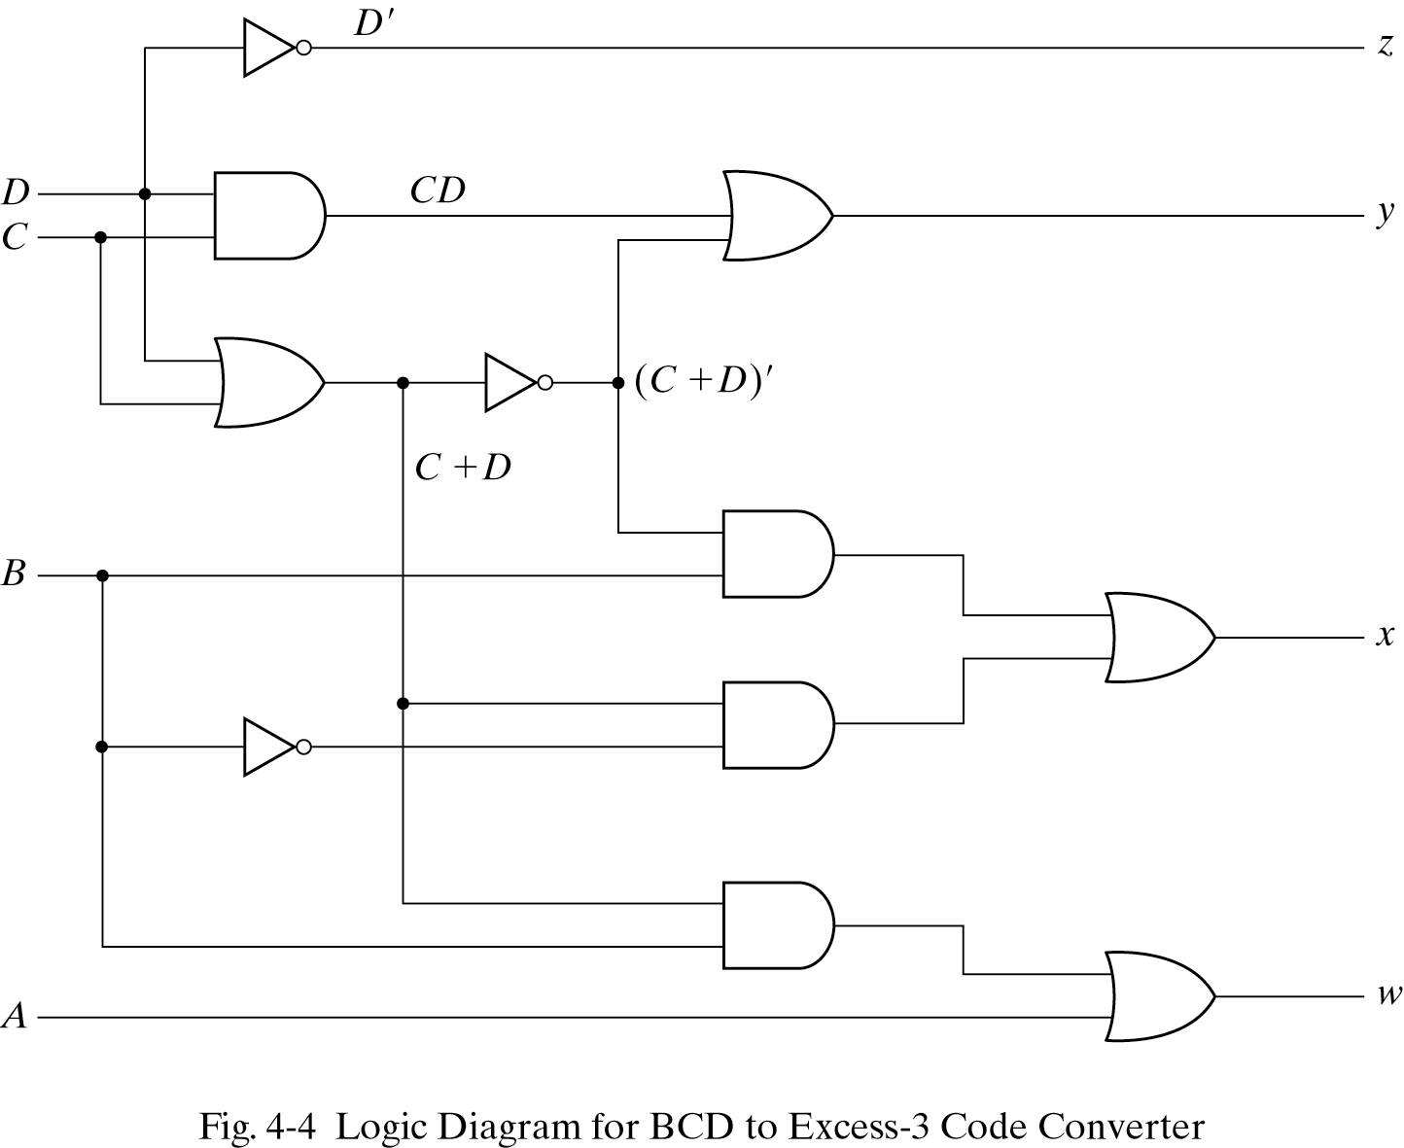
BCD to XS 3 code converter- Design (4)

Slide 31
OTHER COMBINATIONAL LOGIC CIRCUITS
WEEK 7 AND WEEK 8
(LECTURE 1 OF 3)
COMPARATORS
CODE CONVERTERS

Slide 32
COMPARATORS
Comparator is a combinational logic circuit that compares the magnitudes of two binary quantities to determine which one has the greater magnitude.
In other word, a comparator determines the relationship of two binary quantities.
A exclusive−OR gate can be used as a basic comparator.

Slide 33
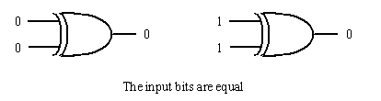
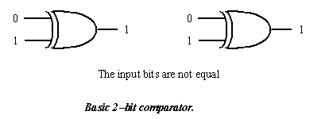
If two input bits are not equal, its output is a 1. But if
two input bits are equal, its output is a 0.
So exclusive−OR gate can be used as a 2−bit Comparator.

Slide 34
In order to compare binary numbers containing two bits each,
an additional XOR gate is necessary
2 LSB of two numbers are compared by gate G1
2 MSB of two numbers are compared by gate G2
2 Inverters and 1 AND gate can be used

Slide 35
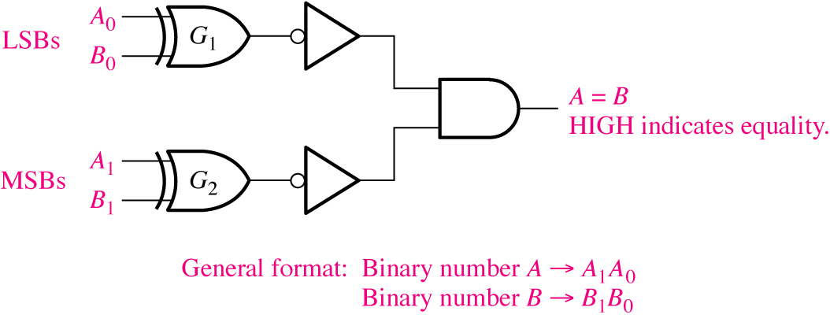
Logic diagram for equality comparison of two 2-bit numbers..
XOR gate and inverter can be replaced by an XNOR symbol, HOW?

Slide 36
Contd...
There are two different types of output relationship between the two binary quantities;
Equality output indicates that the two binary numbers being compared is equal (A = B) and
Inequality output that indicates which of the two binary number being compared is the larger.
That is, there is an output that indicates when A is greater than B (A > B) and an output that indicates when A is less than B (A < B).

Slide 37
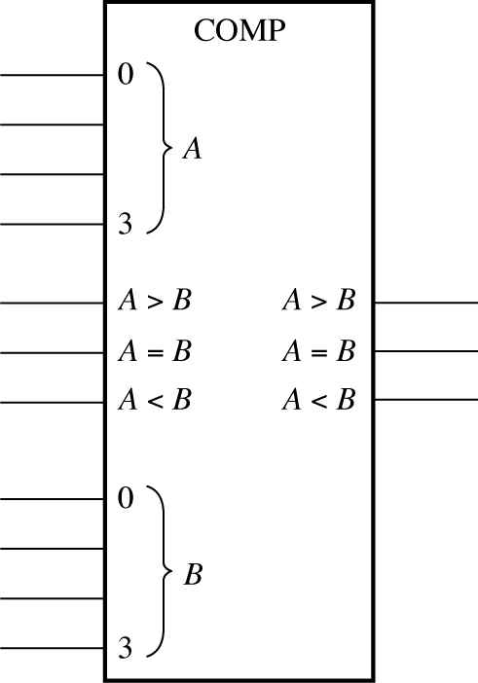
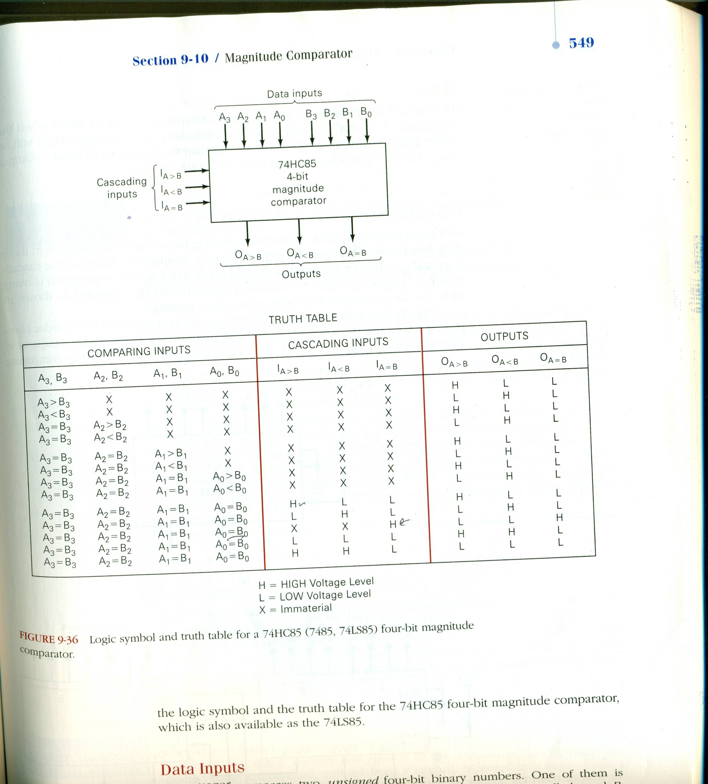
74LS85 (4−bit magnitude comparator)
The 74LS85 compares two unsigned 4-bit binary numbers , the unsigned numbers are A₃, A₂, A₁, A₀ and B₃, B₂, B₁, B₀.
Cascading
Inputs
Outputs

Slide 38
It has three active-HIGH outputs
Start with most significant bit in each number to determine the inequality of 4-bit binary numbers A and B
Output A<B will be HIGH if A₃=0, and B₃=1
Output A>B will be HIGH if A₃=1, and B₃=0
If A₃=0, and B₃=0 or A₃=1, and B₃=1, then examine the next lower order bit position for an inequality.Only when all bits of A=B, output A=B will be HIGH

Slide 39
The general procedure used in comparator:
Start with the highest-order bits (MSB)
When an inequality is found, the relationship of the 2
numbers is established, and any other inequalities in lower-
order positions must be ignored
THE HIGHEST ORDER INDICATION MUST TAKE
PRECEDENCE

Slide 40
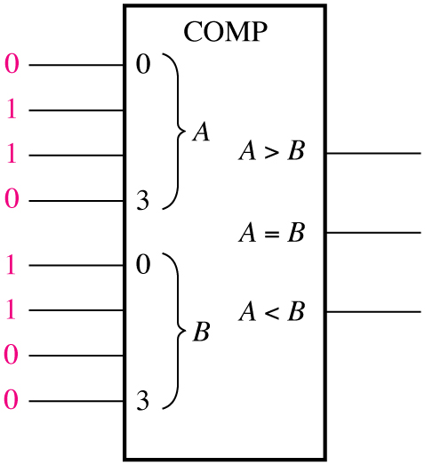
Example: Determine the A=B, A>B, and A<B outputs for the input numbers shown on the 4-bit comparator as given below.
Solution: The number on the A inputs is 0110 and the number on the B inputs is 0011. The A > B output is HIGH and the other outputs (A=B and A<B) are LOW

Slide 41
Contd...
In addition, it also has three cascading inputs:
These inputs provides a means for expanding the comparison operation by cascading two or more 4−bit comparator.
To expand the comparator, the A<B, A=B, and A>B outputs of the lower−order comparator are connected to the corresponding cascading inputs of the next higher−order comparator.

Slide 42
Contd...
The lowest-order comparator must have a HIGH on the A=B, and LOWs on the A<B and A>B inputs as shown in next slide.
The comparator on the left is comparing the lower-order 8−bit with the comparator on the right with higher−order 8−bit .
The outputs of the lower−order bits are fed to the cascade inputs of the comparator on the right, which is comparing the high-order bits.
The outputs of the high-order comparator are the final outputs that indicate the result of the 8−bit comparison.

Slide 43
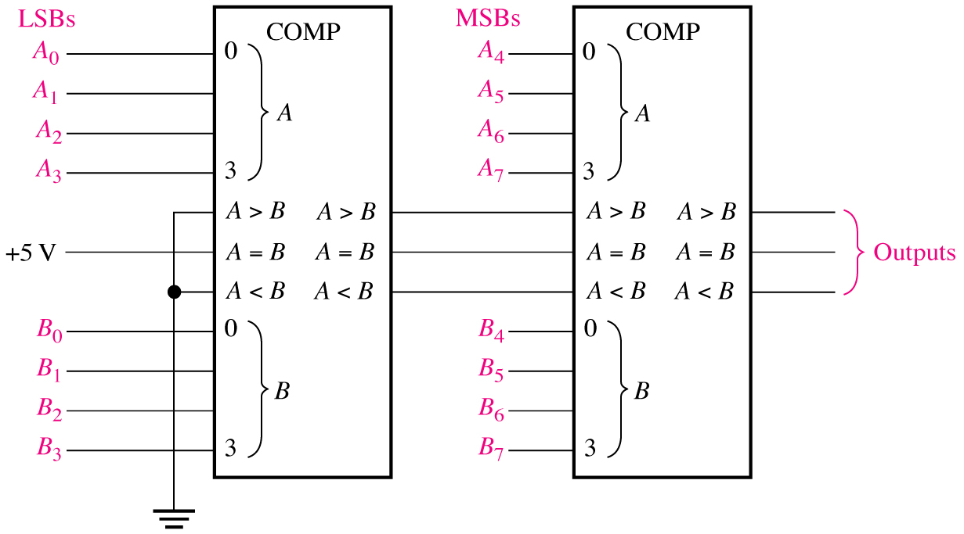
An 8-bit magnitude comparator using two 4-bit comparators.

Slide 44
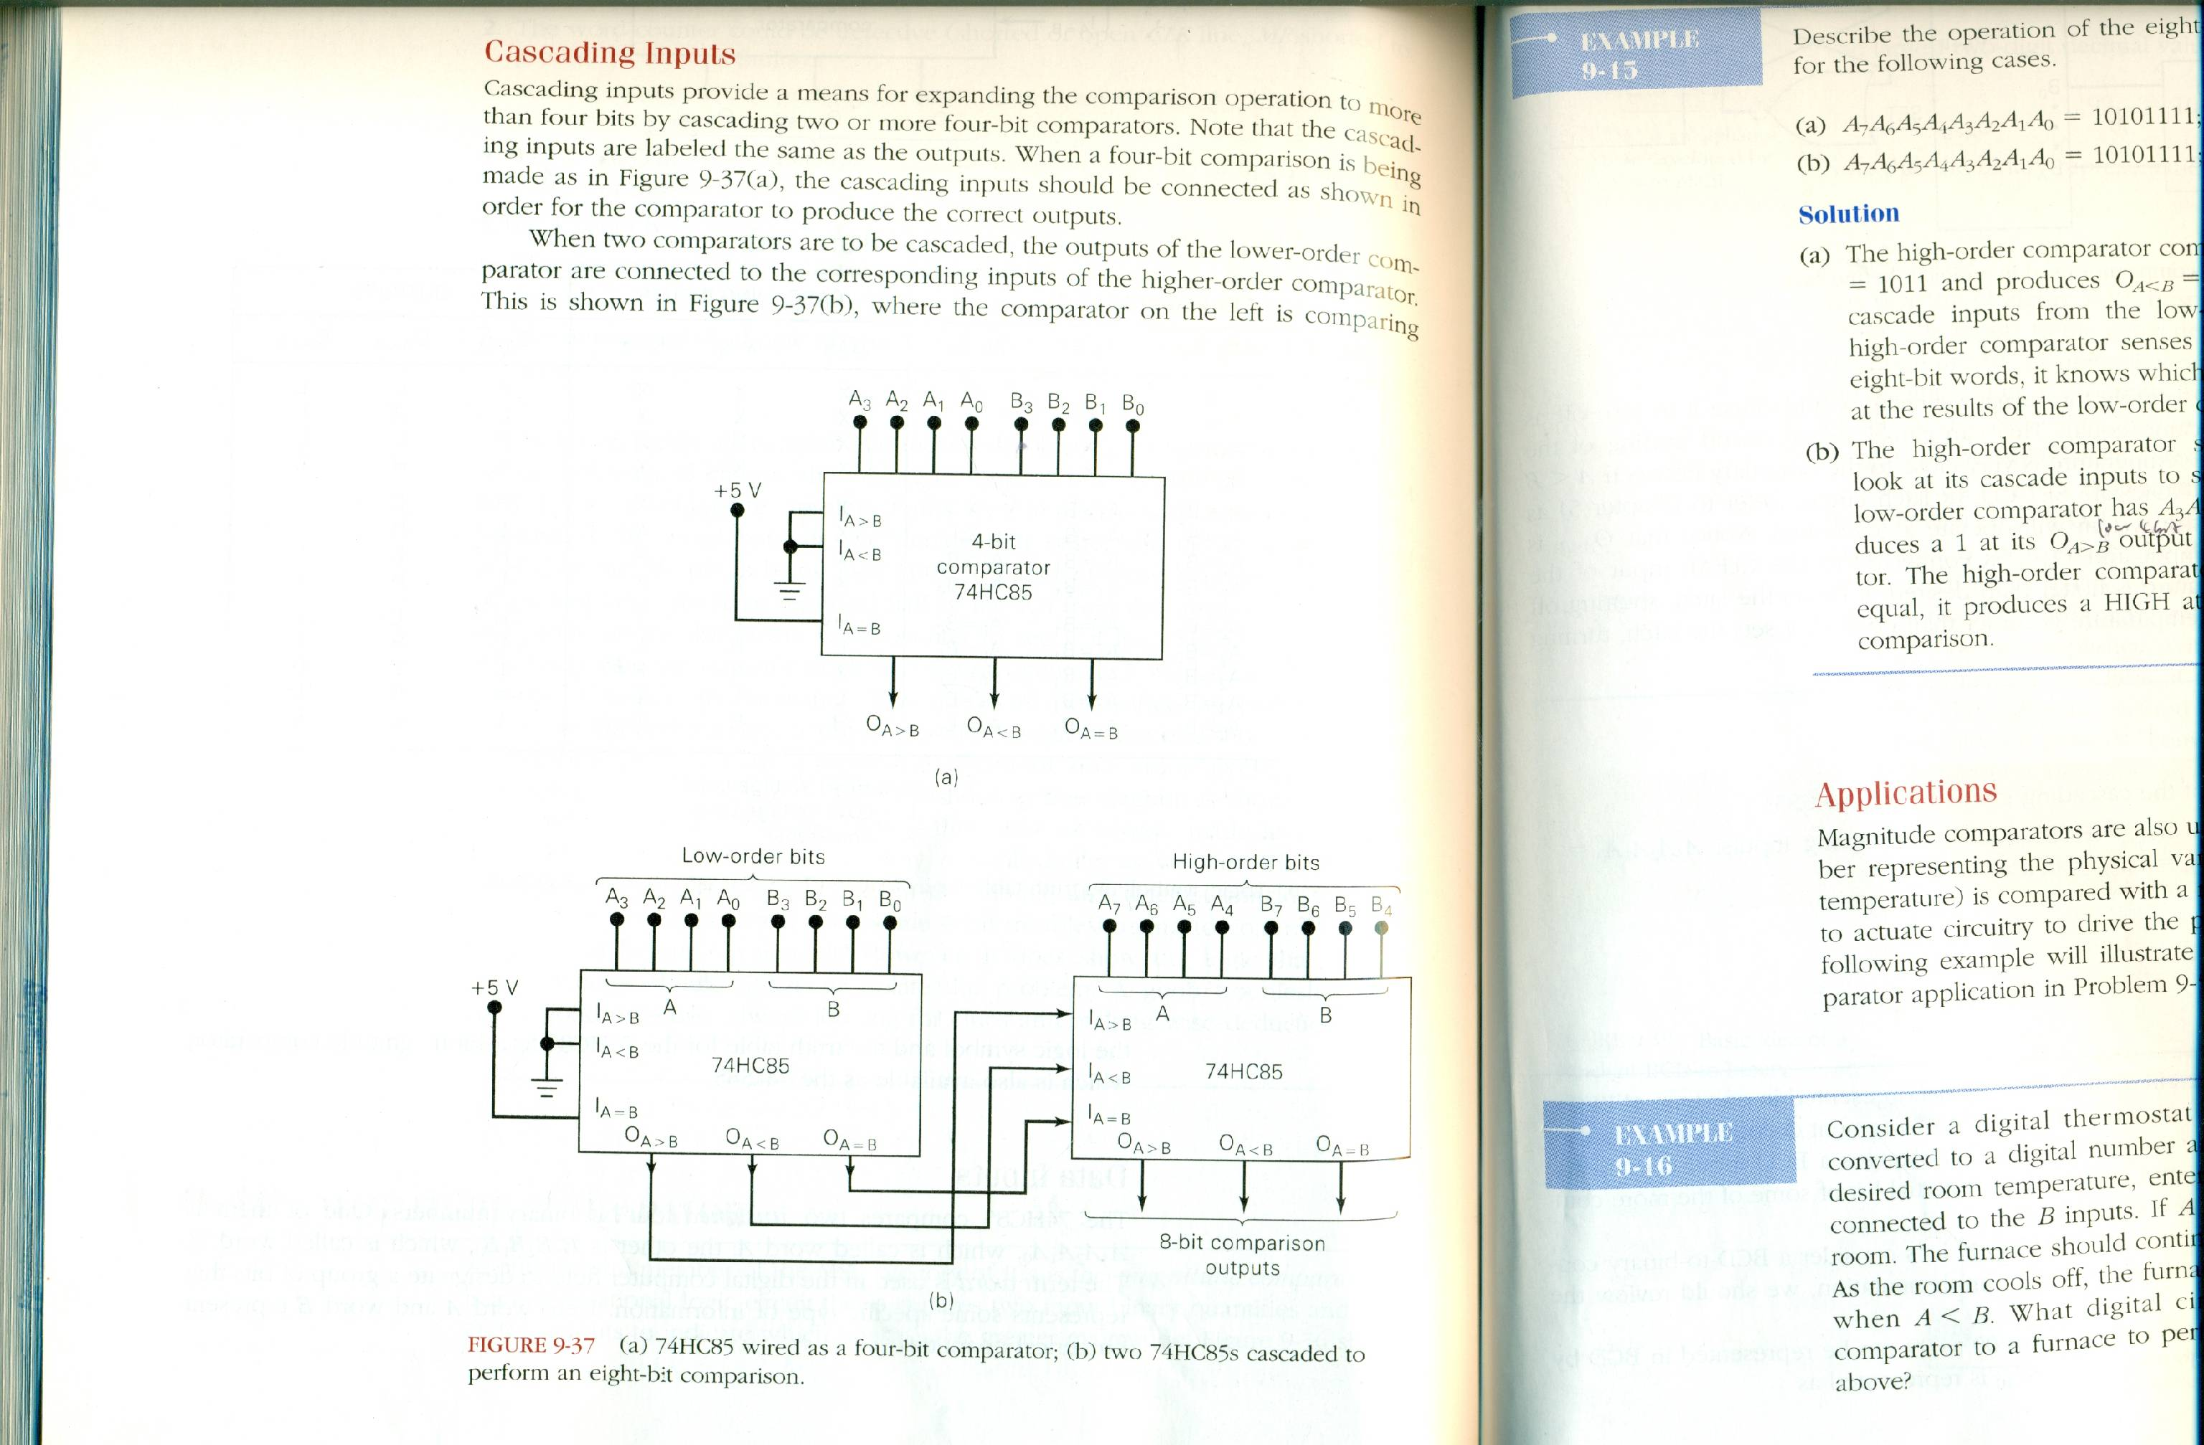

Slide 46
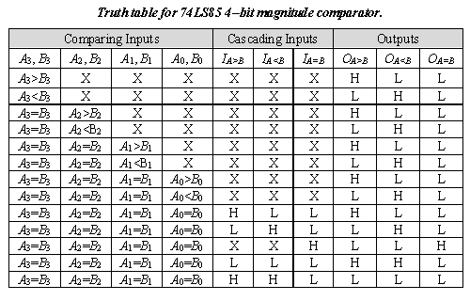

Slide 47
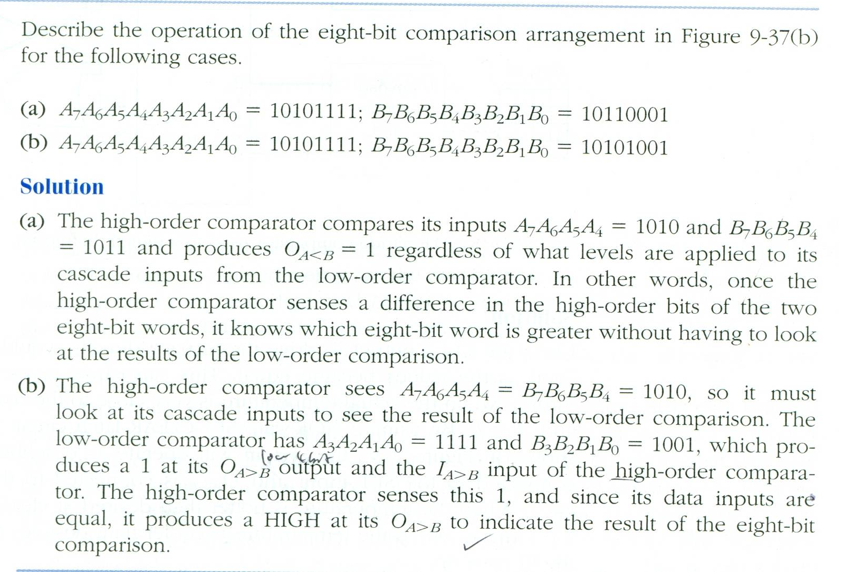

Slide 48
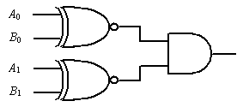
Example :
Determine the output for the following sets of binary
numbers to the comparator inputs in figure below.
(a) 10 and 10 (b) 11 and 10
Solution
    a )The output is 1 (b) The output is 0

